Slide 1
Introduction to Coding
By
G S Prashanth Narayana
U01928107
Final Project -
Restaurant Management System using Tkinter

Slide 2
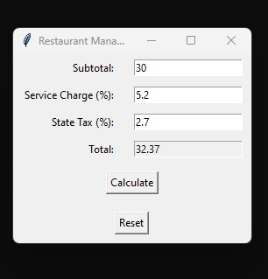
About the project
The Restaurant Management System is a Tkinter-based application designed to help restaurant owners or managers calculate the total bill amount, including service charge, state tax, and tip. It also provides a feature to split the bill among multiple people.

Slide 3
Key Features
Input Fields: Users can input the subtotal, service charge percentage, tip percentage, and number of people splitting the bill.
Tip Calculation: The application calculates the tip amount based on the subtotal and the chosen tip percentage. Users can select from predefined tip percentages (10%, 15%, or 20%) or enter a custom tip percentage.
Total Calculation: The system computes the total bill amount, including the subtotal, service charge, and tip.

Slide 4
4. Bill Splitting: Users can specify the number of people splitting the bill, and the application calculates the amount each person owes.
5. Reset Functionality: A reset button allows users to clear all input fields, facilitating quick data entry for the next transaction.
6. Error Handling: The application includes error handling mechanisms to ensure that users enter valid numeric values and select a tip percentage. Error messages prompt users to correct any input errors.

Slide 5
User Interface
The application has a simple and intuitive user interface built using Tkinter. It consists of:
Labels for each input field and output
Entry fields for the user to enter the subtotal, service charge percentage, state tax percentage, tip percentage, and number of people to split the bill
Buttons for the predefined tip percentages (10%, 15%, 20%)
"Calculate" button to compute the total amount
"Split" button to split the bill among the specified number of people
"Reset" button to clear all the input fields

Slide 6
Benefits
Enhances Efficiency: Streamlines restaurant billing processes, reducing manual errors.
Improves Accuracy: Calculates bills accurately, ensuring customers are charged correctly.
User-Friendly Interface: Provides an intuitive interface for ease of use by restaurant owners and staff.
Customer Satisfaction: Ensures smooth transactions, leading to increased customer satisfaction.

Slide 7
Link of any tutorial/material used
https://www.javatpoint.com/eight-amazing-ideas-of-python-tkinter-projects
Tkinter Documentation: The official documentation for Tkinter provides comprehensive information, tutorials, and examples for building GUI applications with Python's Tkinter library.
Real Python Tkinter Tutorial: Real Python offers a beginner-friendly tutorial on building GUI applications with Tkinter. It covers everything from basic concepts to advanced topics with practical examples.
Python SQLite Tutorial: If you're interested in integrating SQLite databases into your projects, you can refer to tutorials and documentation on using SQLite with Python. The official SQLite website provides comprehensive documentation and tutorials.
Python Documentation: The official Python documentation is an invaluable resource for learning about the Python programming language and its standard libraries. It includes tutorials, guides, and references for various aspects of Python development.
Online Courses: Platforms like Coursera, Udemy, and Codecademy offer online courses on Python programming, GUI development, database management, and related topics. You can explore these platforms to find courses that match your learning goals and preferences.
YouTube Tutorials: There are numerous tutorial videos available on YouTube covering Python programming, Tkinter, SQLite, and other relevant topics. You can search for tutorials that suit your learning style and preferences.

Slide 8
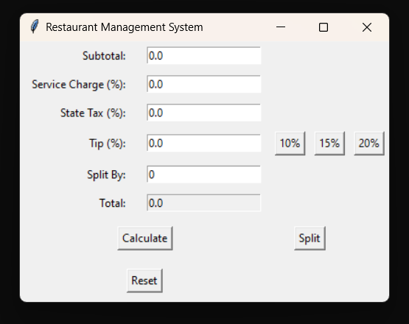
Points on customization you made
Added Tip percentage as US is famous for its tipping Culture
Added Split by to split the bill between people.
Old Interface
New Interface

Slide 9
List of things learnt during this project
Tkinter python library
Data validation
GUI development with Tkinter
Data validation
Mathematical calculations
Error handling
Project organization
Project management
Documentation

